Slide 1
AT Command for Socket 2/2
Zach Lin
Connected Home BG
2023/11/16
Jan. 2012

Slide 2
Outline
Roadmap
AT@SOCKREAD
AT@SOCKDATA
AT@SOCKWRITE
AT@SOCKCLOSE
References

Slide 3
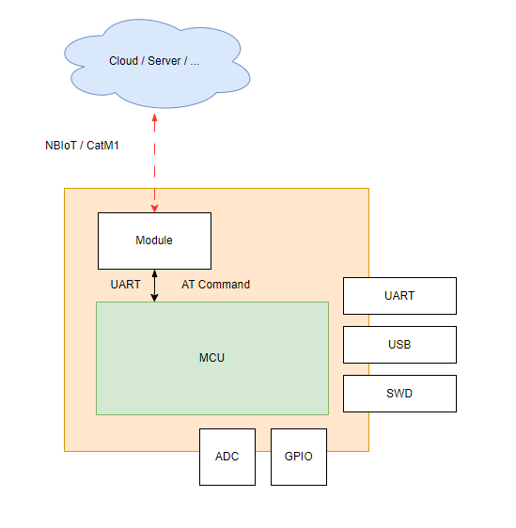
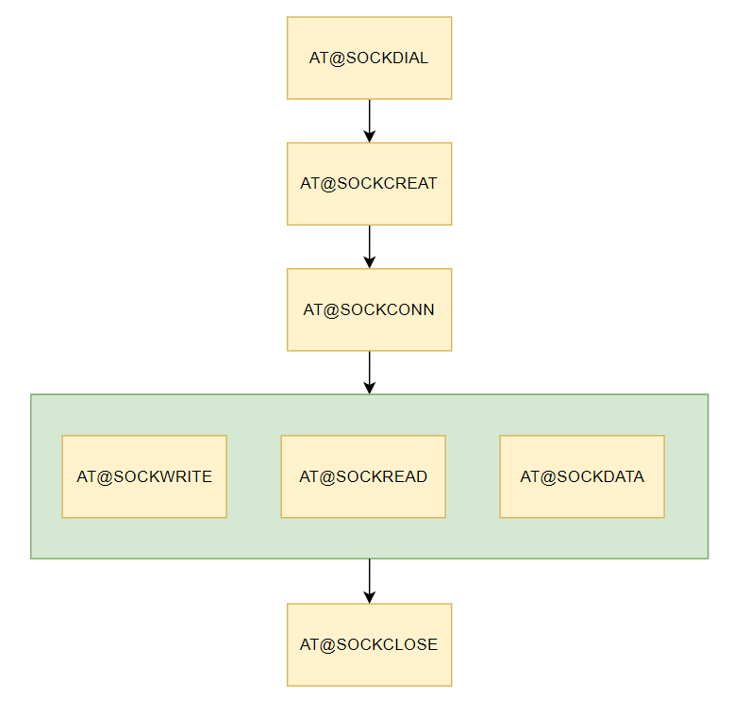
Roadmap

Slide 4
AT@SOCKREAD
This command servers to read the data stored in the buffer of the specified socket
Max payload length is 1500
Command structure
AT@SOCKEREAD=<socket_id>,<max_length>,[binary_form]
AT@SOCKREAD?
AT@SOCKREAD=?

Slide 5
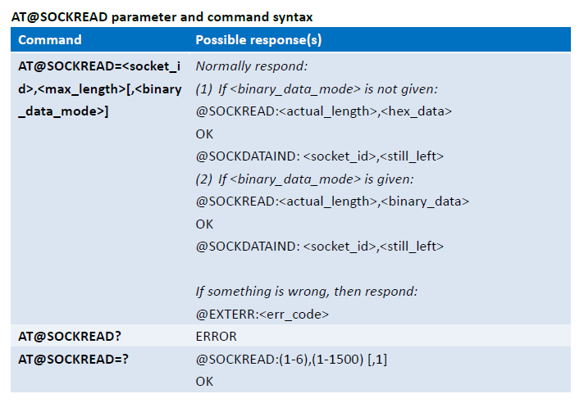
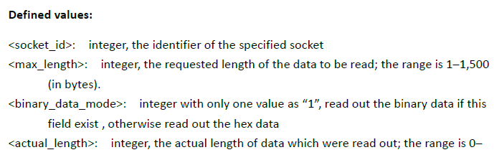
AT@SOCKREAD

Slide 6
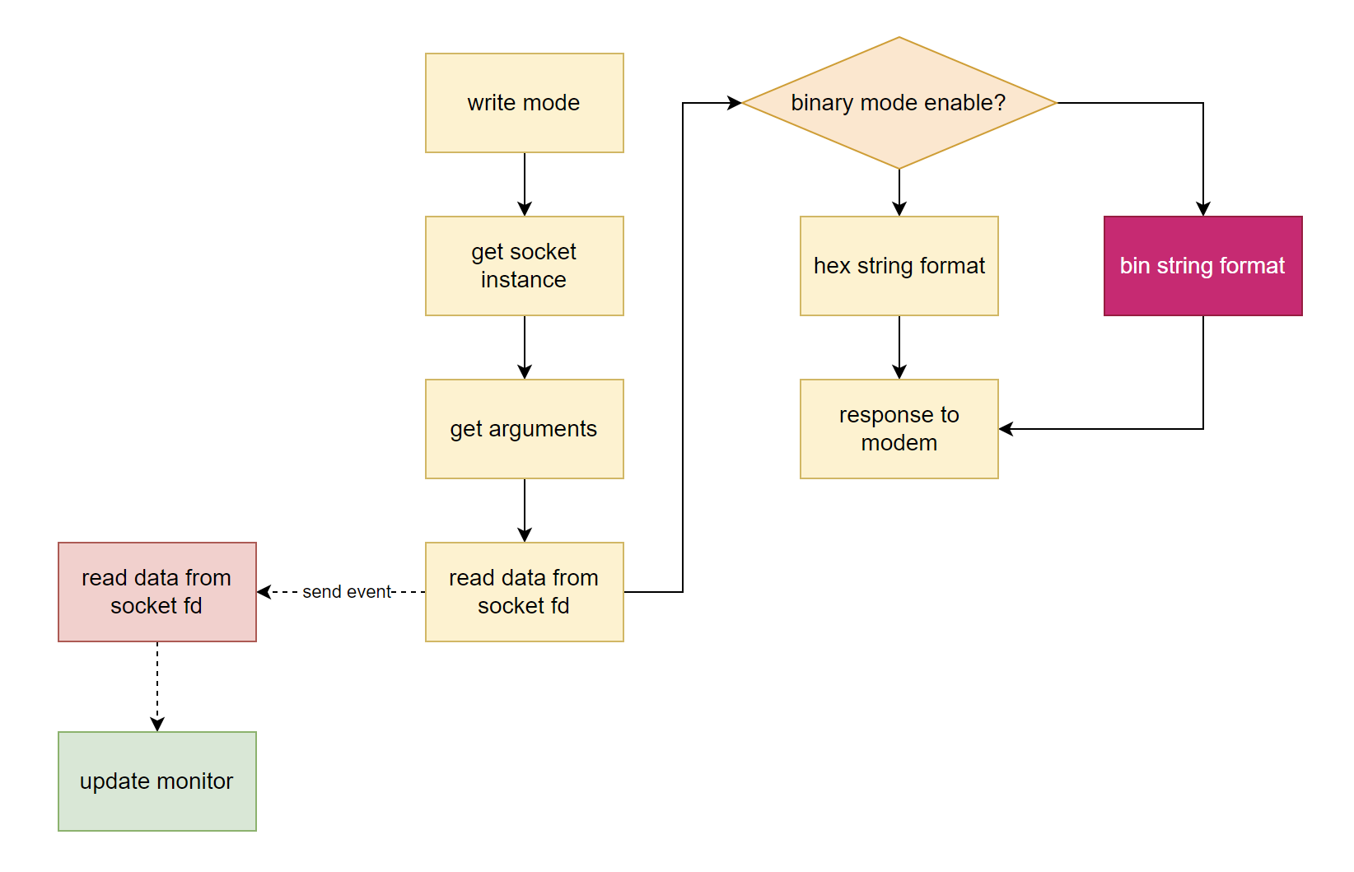
AT@SOCKREAD

Slide 7
AT@SOCKREAD
Response hex format: @SOCKREAD:2,“0102“
Response binary format: @SOCKREAD:2,“0000000100000010“
* no implementation in code
Can be too long
MCU will need extra time to process it (not efficient)

Slide 8
AT@SOCKDATA
This command serves to query the data stored in the buffer of the specified socket
External processor actively asks for information
Command structure
AT@SOCKDATA
AT@SOCKDATA?
AT@SOCKDATA=?

Slide 9
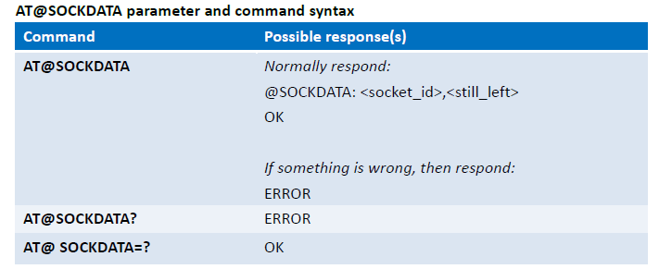
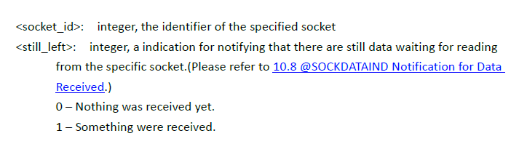
AT@SOCKDATA

Slide 10
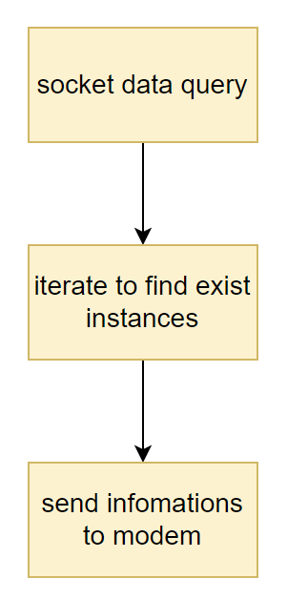
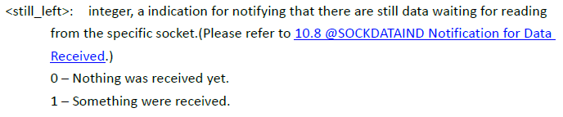
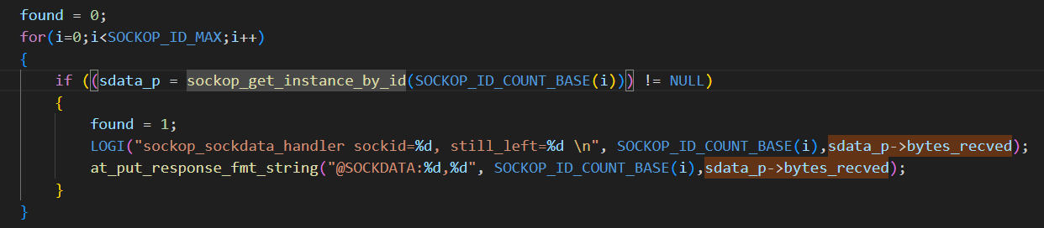
AT@SOCKDATA

Slide 11
AT@SOCKWRITE
This command serves to write data to the specified socket
Max payload length is 1500
Support hex & binary format
Command structure
AT@SOCKWRITE=<socket_id>,<write_bytes>,<data>
AT@SOCKWRITE=<socket_id>,1<CR><data>
AT@SOCKWRITE?
AT@SOCKWRITE=?

Slide 12
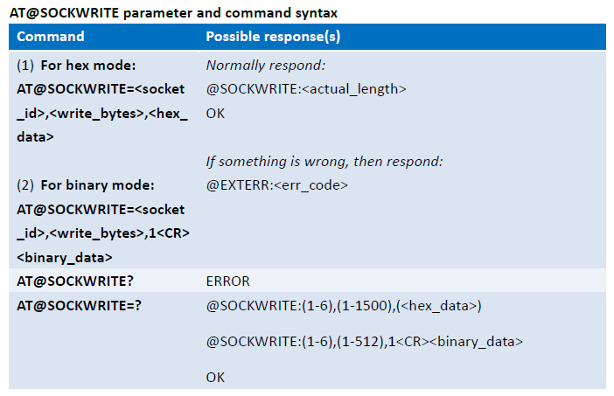
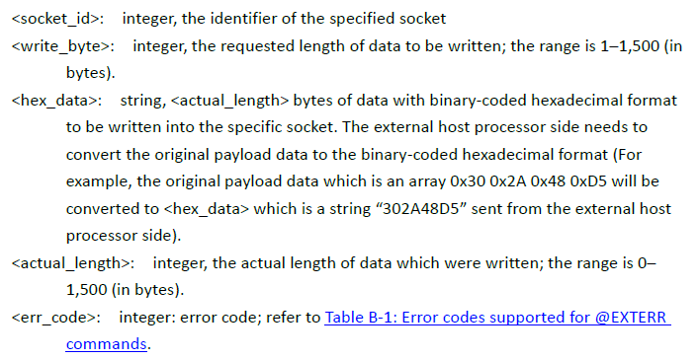
AT@SOCKWRITE

Slide 13
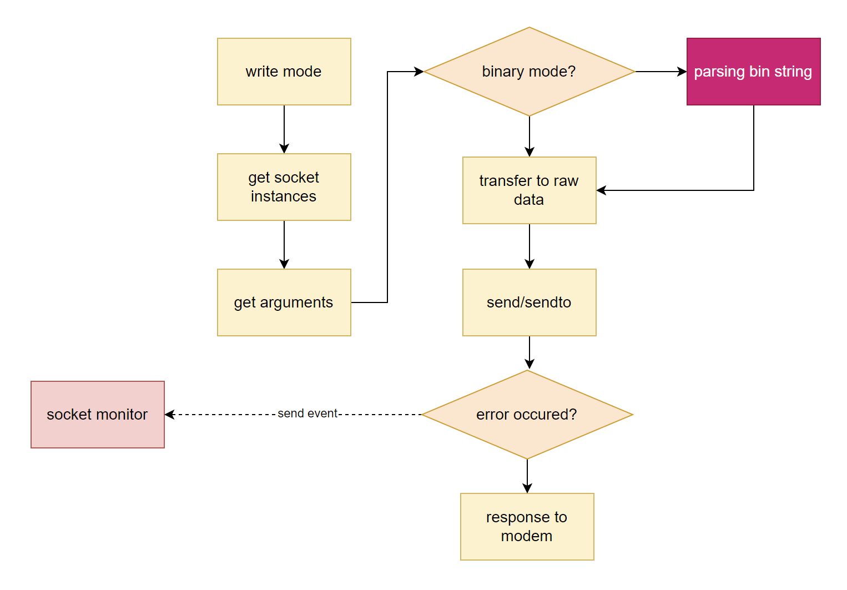
AT@SOCKWRITE

Slide 14
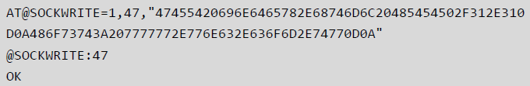
AT@SOCKWRITE
Request hex format: AT@SOCKWRITE:1,2,“0102“
Request binary format: AT@SOCKWRITE:1,2,1 “0000000100000010“

Slide 15
AT@SOCKCLOSE
This command servers to close the specified socket
Not closing the socket is a burden on system resources
External processor can’t create socket
Command structure
AT@SOCKCLOSE=<socket_id>
AT@SOCKCLOSE?
AT@SOCKCLOSE=?

Slide 16
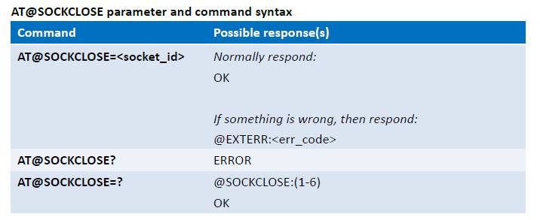
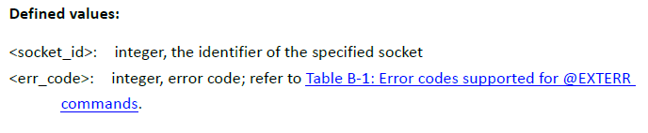
AT@SOCKCLOSE

Slide 17
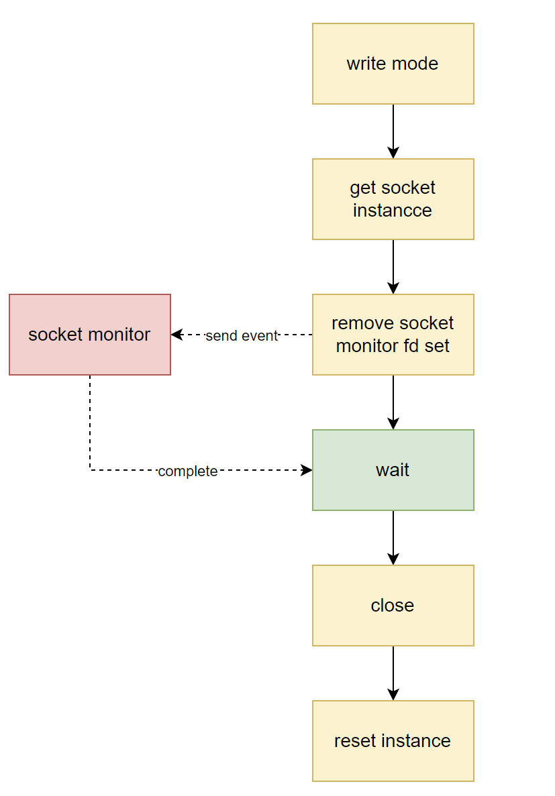
AT@SOCKCLOSE

Slide 18
References
AT Command Guide
mdm9607/

Slide 19
Thank you for your attention

